Slide 1

Propagation of Conformational Coordinates Across Angular Space in Mapping the Continuum of States from Cryo-EM Data by Manifold Embedding
林思涵
2021/02/23

Slide 2
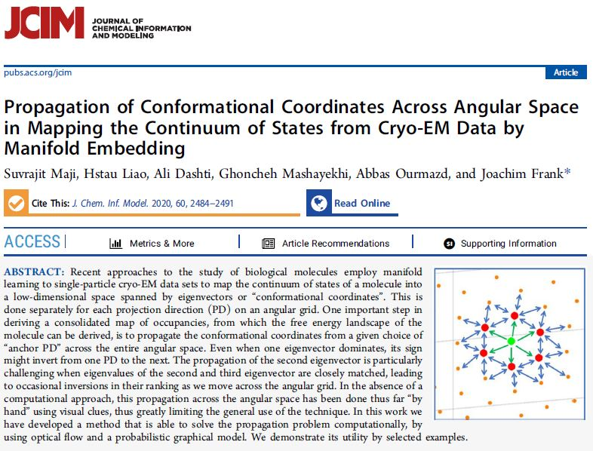

Slide 3
The study of biological molecules employ manifold learning to single-particle cryo-EM data sets to map the continuum of states of a molecule into a low-dimensional space spanned by eigenvectors or “conformational coordinates”.
In this work we have developed a method that is able to solve the propagation problem computationally, by using optical flow and a probabilistic graphical model.

Slide 4
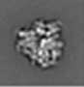
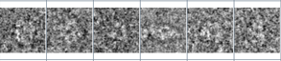
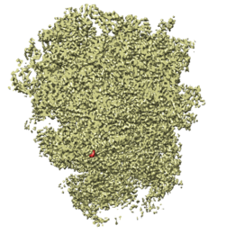
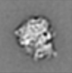
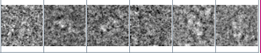

Cryo-EM Analysis Workflow
Motion、CTF
Corrections
Particle Picking
2D Clustering
3D Reconstruction
可能不只一種型態
3D Reconstruction
型態或許是連續的
$$⋮$$
Cleaned particle image set

Slide 5
Propagation method
ManifoldEM
To create a tessellation of the orientation sphere such that the 2D cryo-EM images are classified into bins known as projection directions (PDs).
The images in each PD are aligned,
all the pairwise Euclidean distances are calculated for the images.
Using the distances, the images in each PD are embedded into a low K-dimensional manifold described by K eigenvectors using diffusion maps.
The manifold of images contains the information on conformational changes along each of the eigenvectors.
The conformational information contained in this manifold is now decomposed and sorted along each of the K eigenvectors in the form of conformational movies, using the Nonlinear Laplacian Spectral Analysis.
Due to the sign ambiguity between the same eigenvectors in different PDs, we have forward and reverse directions, so there are 2K movies to compare in each PD.

Slide 6
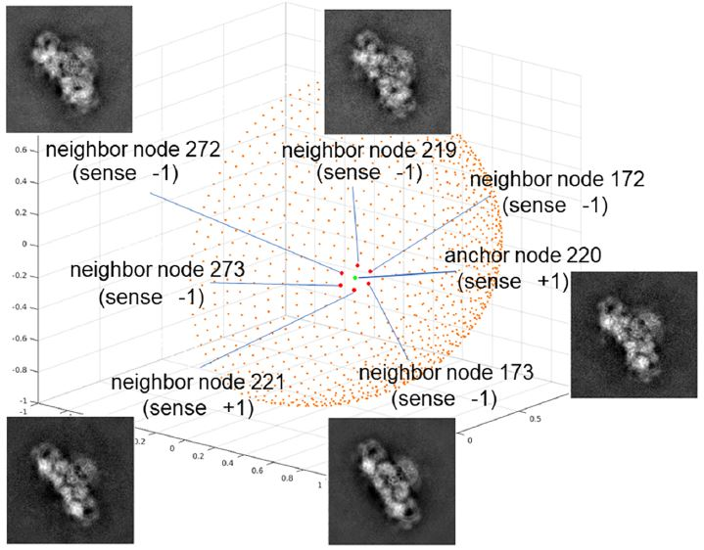
Ryanodine receptor (RyR)
The total number of PDs: 1117
5 movies/PD (K=5)

Slide 7
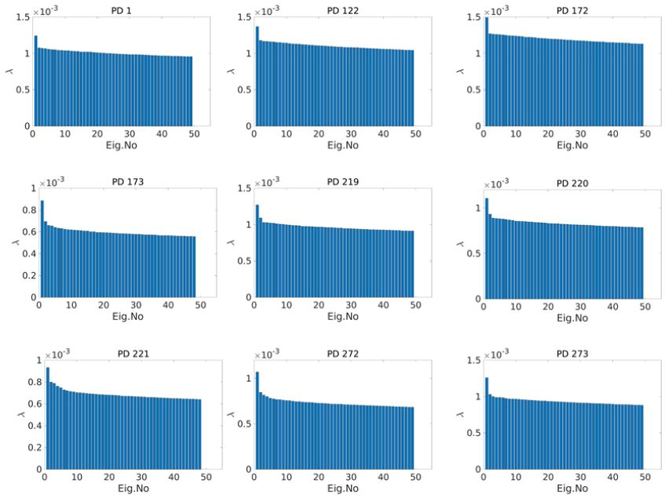
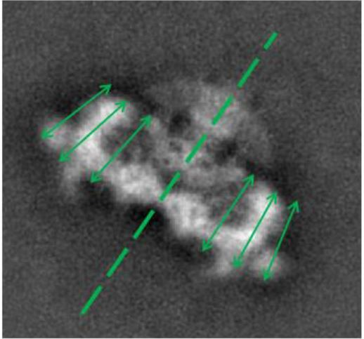
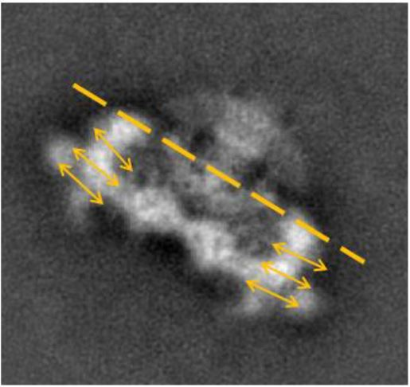
Eigenvalue spectra for the RyR dataset.
.
.
Vertical wing motion
.
.
.
.
.
.
.
Lateral wing motion
.
.
.

Slide 8
Propagation method
Propagation method
Compute the dense optical flow field using the Horn-Schunck method for each movie
Compute the histogram of oriented gradients (HOG) from the optical flow vectors. The HOG feature vector encodes the motion present in the movie.

Slide 9
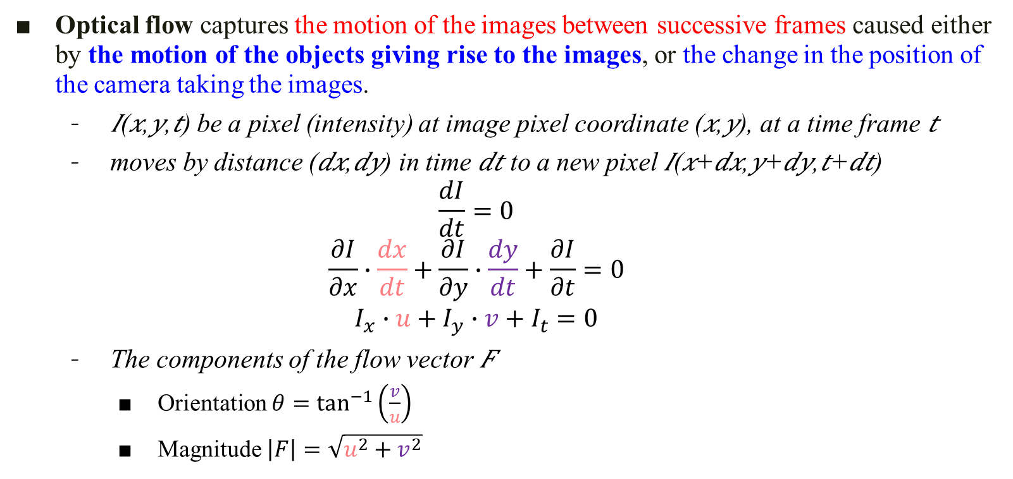
(Text S1) Optical Flow
Optical flow captures the motion of the images between successive frames caused either by the motion of the objects giving rise to the images, or the change in the position of the camera taking the images.
𝐼(𝑥,𝑦,𝑡) be a pixel (intensity) at image pixel coordinate (𝑥,𝑦), at a time frame 𝑡
moves by distance (𝑑𝑥,𝑑𝑦) in time 𝑑𝑡 to a new pixel 𝐼(𝑥+𝑑𝑥,𝑦+𝑑𝑦,𝑡+𝑑𝑡)
$$\frac{dI}{dt}=0$$
$$\frac{∂I}{∂x}∙\frac{dx}{dt}+\frac{∂I}{∂y}∙\frac{dy}{dt}+\frac{∂I}{∂t}=0$$
$$I_{x}∙u+I_{y}∙v+I_{t}=0$$
The components of the flow vector 𝐹
Orientation $θ=\tan^{−1}\left(\frac{v}{u}\right)$
Magnitude $\left|F\right|=\sqrt{u^{2}+v^{2}}$

Slide 10
Ryanodine receptor (RyR)
The total number of PDs: 1117
5 movies/PD (K=5)

Slide 11
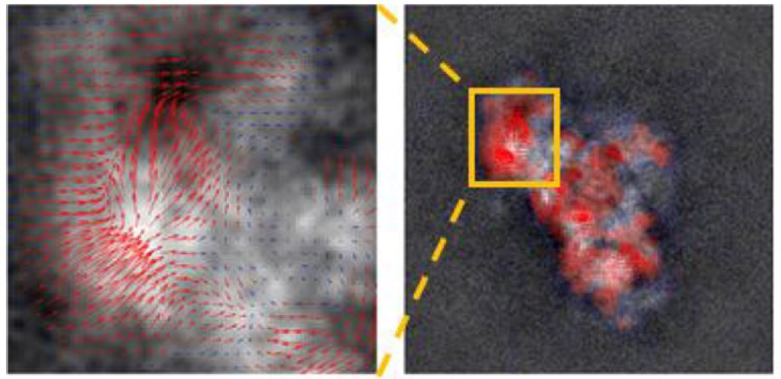
Optical Flow
PD 220
沿著某個eigenfunction方向的movie
所得到的optical flow

Slide 12
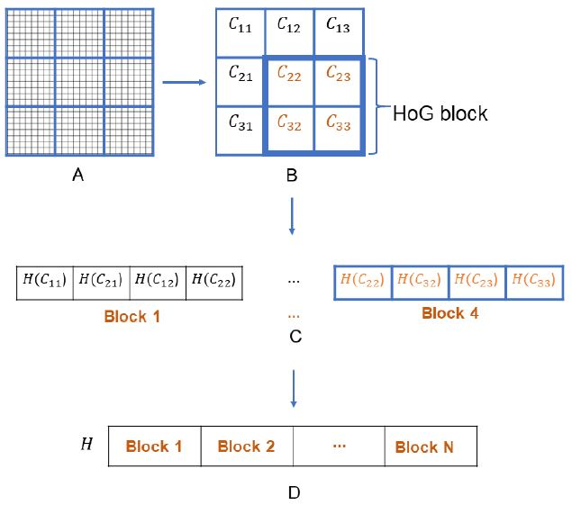
Histogram of Oriented Gradients (HOG)
CellSize = [C C] = [8 8]
BlockSize = [B B] = [2 2]
BlockOverlap = [P P] = [1 1]
H 長度= numBlocks * BlockSize * numBins

Slide 13
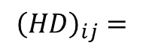
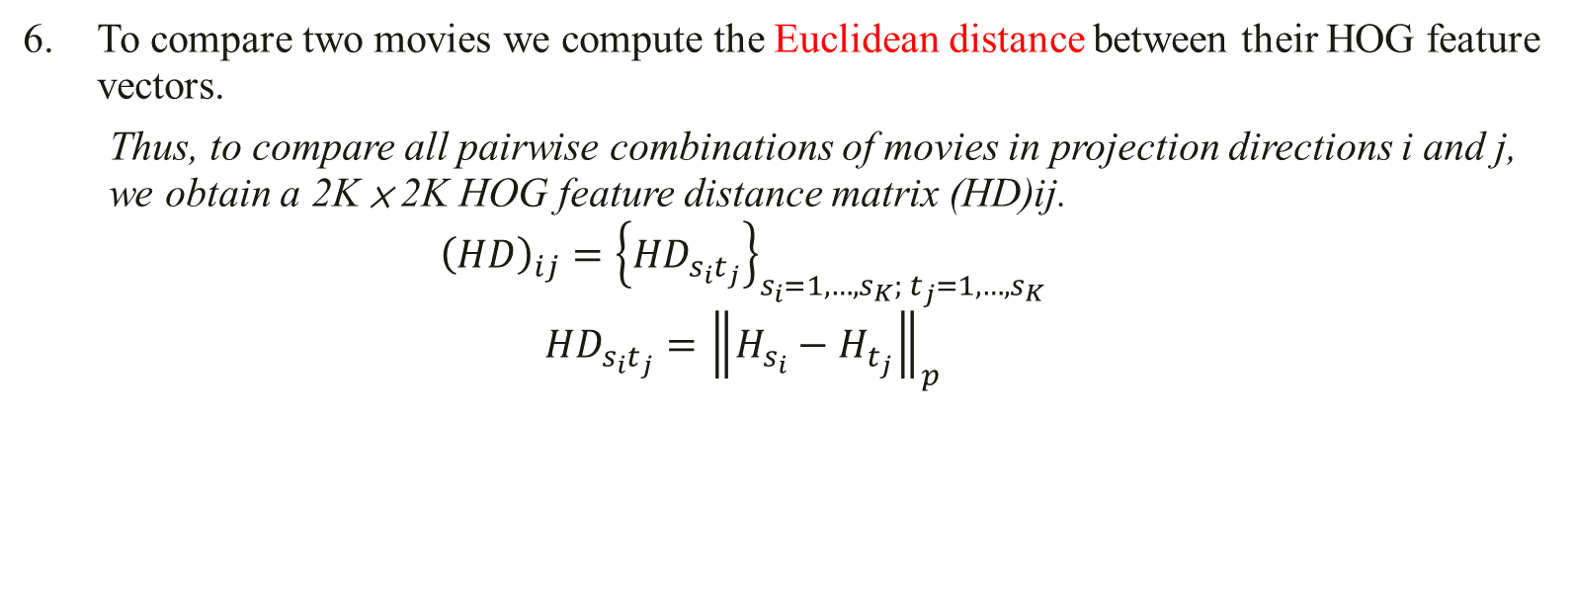
Propagation method
To compare two movies we compute the Euclidean distance between their HOG feature vectors.
Thus, to compare all pairwise combinations of movies in projection directions i and j, we obtain a 2K × 2K HOG feature distance matrix (HD)ij.
$${\left(HD\right)}_{ij}={\left\{{HD}_{s_{i}t_{j}}\right\}}_{s_{i}=1,…,s_{K}; t_{j}=1,…,s_{K}}$$
$${HD}_{s_{i}t_{j}}={\left\|H_{s_{i}}−H_{t_{j}}\right\|}_{p}$$
Node i \ Node j | 1…K forward directions |  | 1…K reverse directions
1…K forward directions
1…K reverse directions
$${\left(HD\right)}_{ij}=$$

Slide 14
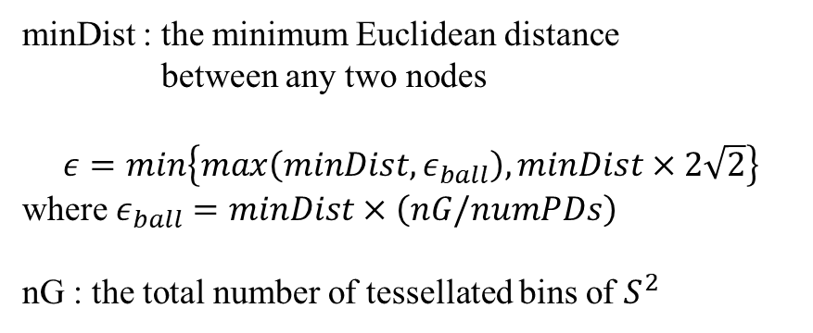
Propagation method
We then formulate the conformational coordinate selection process as an optimization problem using a graphical model, defined over the angular grid.
The PDs are the nodes of the graph, and two nodes are connected by an edge if they are within a certain distance ϵ.
Ryanodine receptor (RyR)
The total number of PDs: 1117
minDist : the minimum Euclidean distance
between any two nodes
$$ε=min\left\{max\left(minDist, ε_{ball}\right), minDist×2\sqrt{2}\right\}$$
where $ε_{ball}=minDist×\left(nG/numPDs\right)$
nG : the total number of tessellated bins of $S^{2}$

Slide 15
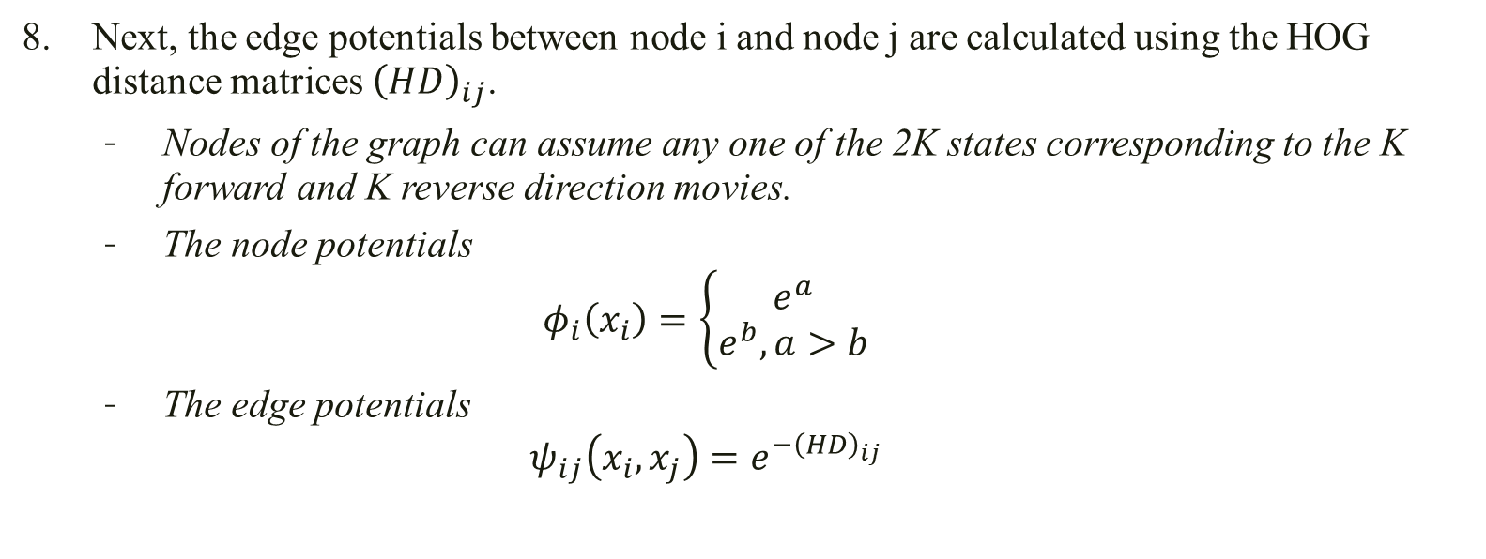
Propagation method
Next, the edge potentials between node i and node j are calculated using the HOG distance matrices ${\left(HD\right)}_{ij}$.
Nodes of the graph can assume any one of the 2K states corresponding to the K forward and K reverse direction movies.
The node potentials
$$φ_{i}\left(x_{i}\right)=\left\{\begin{matrix}e^{a} \\ e^{b}, a>b\end{matrix}\right.$$
The edge potentials
$$ψ_{ij}\left(x_{i},x_{j}\right)=e^{−{\left(HD\right)}_{ij}}$$
if node i is an anchor
otherwise
(In RyR, 9 of those PDs were randomly designated as anchors)

Slide 16
Propagation method
The goal is to find a consensus labeling across the entire angular grid using our propagation algorithm by comparing movies in neighboring nodes.
We achieve this goal by using belief propagation, which tries to determine the probability (belief) of a node being in a particular state in an iterative manner, given the reference movies in a few PDs called “anchors”.
To obtain the best state label we compute the maxima of the beliefs.

Slide 17
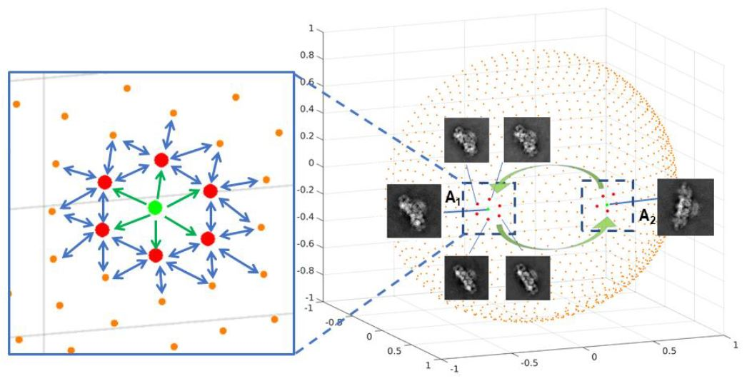
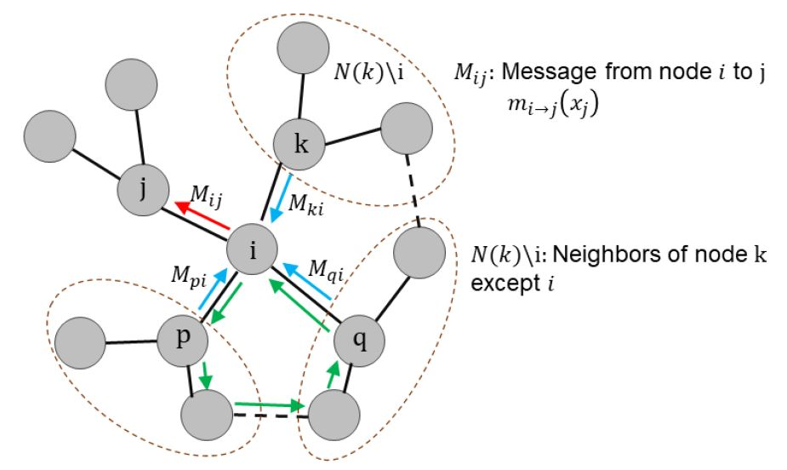
Belief propagation (BP)
Probabilistic Graphical Models(PGMs)
<Undirected Graphical Models>
Markov Random Fields
Belief propagation (BP) and its variants provide approximate solution to the inference problems for a general graphical model.
BP operates by iteratively sending messages along the edges of graph.

Slide 18
Belief propagation (BP)
Probabilistic Graphical Models(PGMs) - Markov Random Fields
The anchor nodes
As the assignment of eigenvector and sense is known for each anchor node
we give a higher confidence to the state values of the anchor nodes
those values are not allowed to change after the propagation is completed.

Slide 19
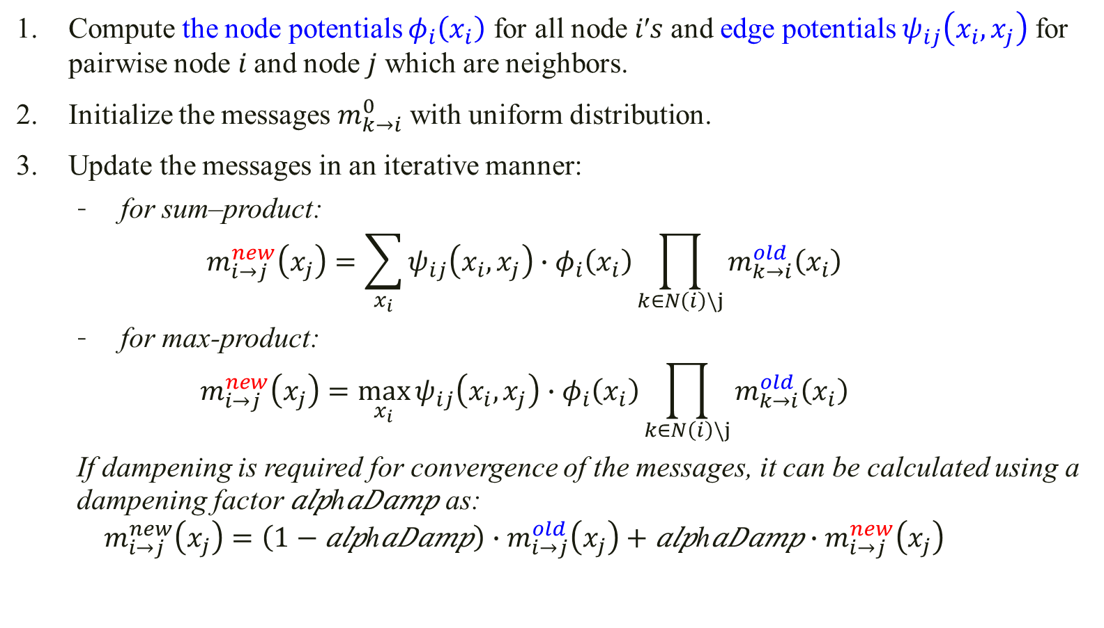
Belief propagation algorithm
Compute the node potentials $φ_{i}\left(x_{i}\right)$ for all node 𝑖′𝑠 and edge potentials $ψ_{ij}\left(x_{i},x_{j}\right)$ for pairwise node 𝑖 and node 𝑗 which are neighbors.
Initialize the messages $m_{k→i}^{0}$ with uniform distribution.
Update the messages in an iterative manner:
for sum–product:
$$m_{i→j}^{new}\left(x_{j}\right)=\sum_{x_{i}}{ψ_{ij}\left(x_{i},x_{j}\right)∙φ_{i}\left(x_{i}\right)\prod_{k∈N\left(i\right)\backslash j}{m_{k→i}^{old}\left(x_{i}\right)}}$$
for max-product:
$$m_{i→j}^{new}\left(x_{j}\right)=\max_{x_{i}}{ψ_{ij}\left(x_{i},x_{j}\right)∙φ_{i}\left(x_{i}\right)\prod_{k∈N\left(i\right)\backslash j}{m_{k→i}^{old}\left(x_{i}\right)}}$$
If dampening is required for convergence of the messages, it can be calculated using a dampening factor 𝑎𝑙𝑝h𝑎𝐷𝑎𝑚𝑝 as:
$$m_{i→j}^{new}\left(x_{j}\right)=\left(1−\text{alp}\text{h}\text{aDamp}\right)∙m_{i→j}^{old}\left(x_{j}\right)+\text{alp}\text{h}\text{aDamp}∙m_{i→j}^{new}\left(x_{j}\right)$$

Slide 20
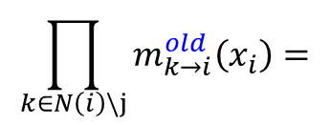

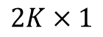
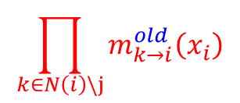
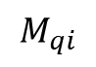

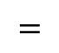
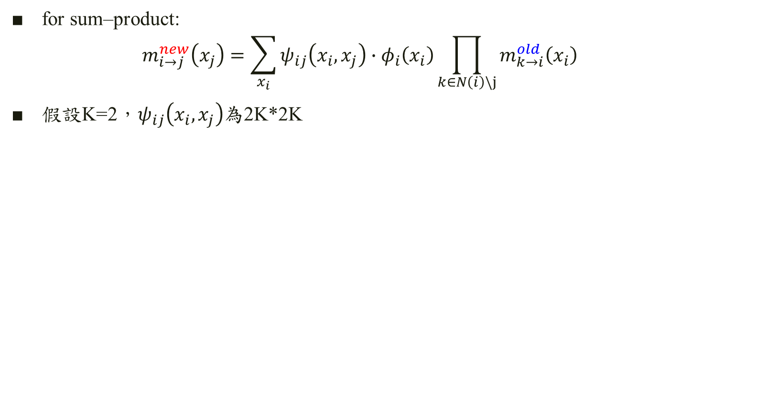

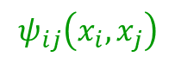
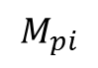

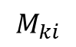


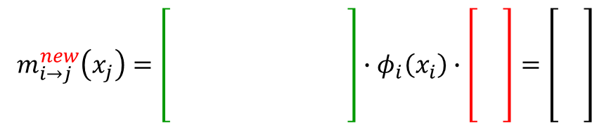
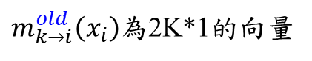


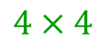
for sum–product:
$$m_{i→j}^{new}\left(x_{j}\right)=\sum_{x_{i}}{ψ_{ij}\left(x_{i},x_{j}\right)∙φ_{i}\left(x_{i}\right)\prod_{k∈N\left(i\right)\backslash j}{m_{k→i}^{old}\left(x_{i}\right)}}$$
假設K=2，$ψ_{ij}\left(x_{i},x_{j}\right)$為2K*2K
$m_{k→i}^{old}\left(x_{i}\right)$為2K*1的向量
$$M_{ki}$$
$$M_{pi}$$
$$M_{qi}$$
$$×$$
$$×$$
$$\prod_{k∈N\left(i\right)\backslash j}{m_{k→i}^{old}\left(x_{i}\right)}=$$
$$×$$
$$×$$
$$=$$
$$×$$
$$×$$
$$×$$
$$×$$
$$2K×1$$
$$\prod_{k∈N\left(i\right)\backslash j}{m_{k→i}^{old}\left(x_{i}\right)}$$
$$ψ_{ij}\left(x_{i},x_{j}\right)$$
$$m_{i→j}^{new}\left(x_{j}\right)=\left[\begin{matrix}\begin{matrix} & \\ & \end{matrix} & \begin{matrix} & \\ & \end{matrix} \\ \begin{matrix} & \\ & \end{matrix} & \begin{matrix} & \\ & \end{matrix}\end{matrix}\right]∙φ_{i}\left(x_{i}\right)∙\left[\begin{matrix} \\ \\ \begin{matrix} \\ \end{matrix}\end{matrix}\right]=\left[\begin{matrix} \\ \\ \begin{matrix} \\ \end{matrix}\end{matrix}\right]$$
$$4×4$$

Slide 21
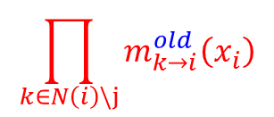
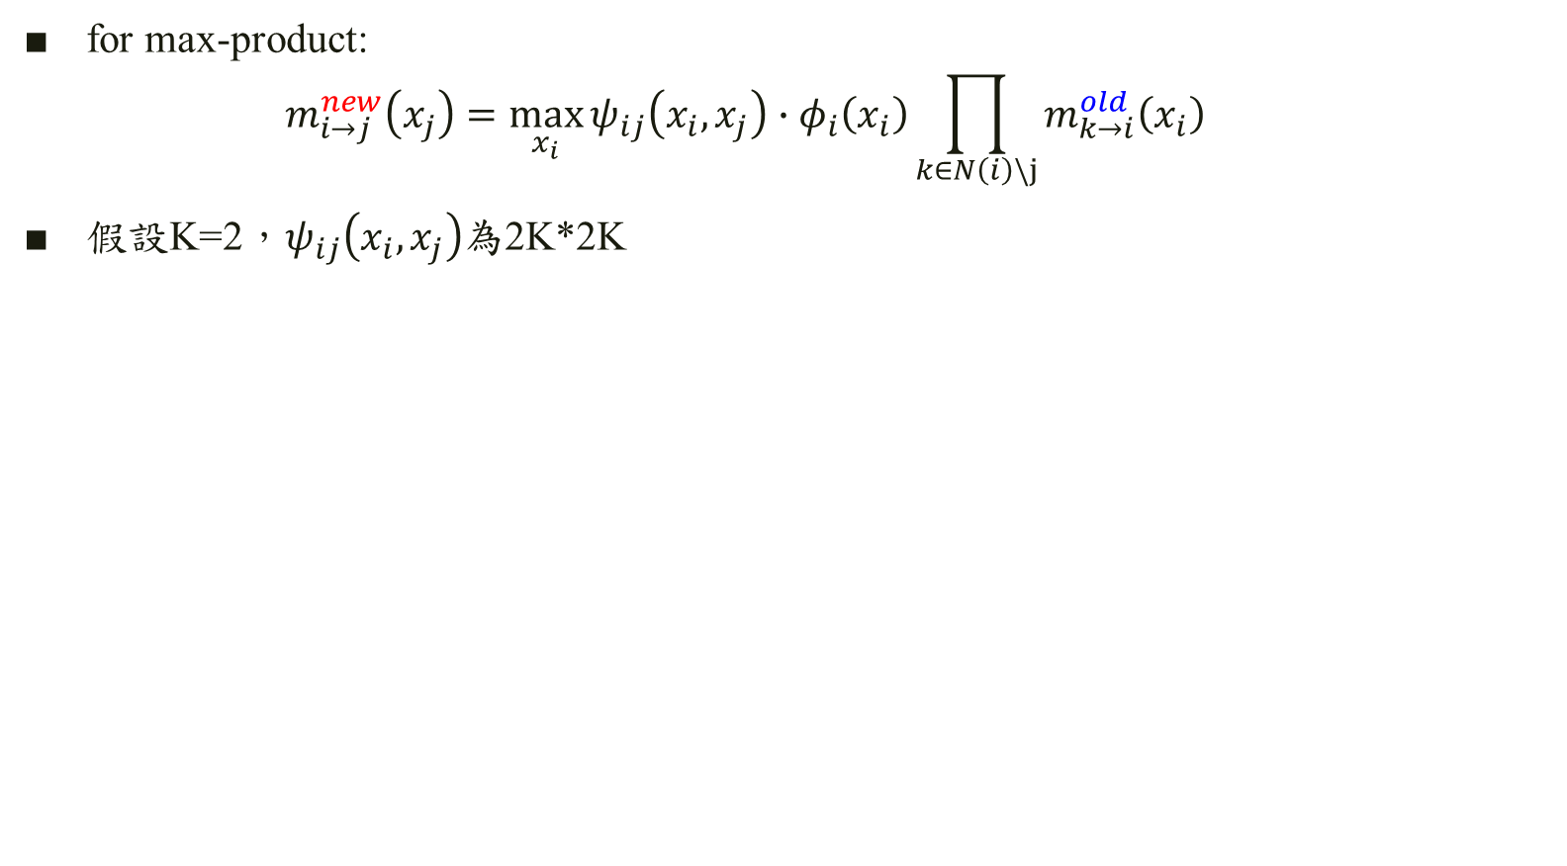
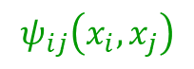
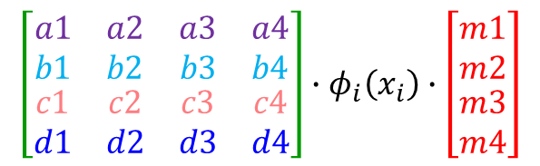
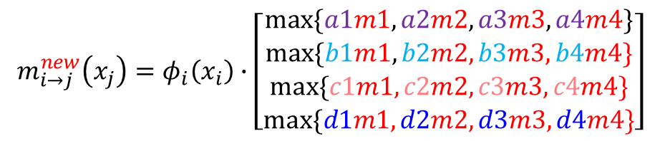
for max-product:
$$m_{i→j}^{new}\left(x_{j}\right)=\max_{x_{i}}{ψ_{ij}\left(x_{i},x_{j}\right)∙φ_{i}\left(x_{i}\right)\prod_{k∈N\left(i\right)\backslash j}{m_{k→i}^{old}\left(x_{i}\right)}}$$
假設K=2，$ψ_{ij}\left(x_{i},x_{j}\right)$為2K*2K
$m_{k→i}^{old}\left(x_{i}\right)$為2K*1的向量
$$M_{ki}$$
$$M_{pi}$$
$$M_{qi}$$
$$×$$
$$×$$
$$\prod_{k∈N\left(i\right)\backslash j}{m_{k→i}^{old}\left(x_{i}\right)}=$$
$$×$$
$$×$$
$$=$$
$$×$$
$$×$$
$$×$$
$$×$$
$$2K×1$$
$$\prod_{k∈N\left(i\right)\backslash j}{m_{k→i}^{old}\left(x_{i}\right)}$$
$$ψ_{ij}\left(x_{i},x_{j}\right)$$
$$\left[\begin{matrix}\begin{matrix}a1 & a2 \\ b1 & b2\end{matrix} & \begin{matrix}a3 & a4 \\ b3 & b4\end{matrix} \\ \begin{matrix}c1 & c2 \\ d1 & d2\end{matrix} & \begin{matrix}c3 & c4 \\ d3 & d4\end{matrix}\end{matrix}\right]∙φ_{i}\left(x_{i}\right)∙\left[\begin{matrix}m1 \\ m2 \\ \begin{matrix}m3 \\ m4\end{matrix}\end{matrix}\right]$$
$$m_{i→j}^{new}\left(x_{j}\right)=φ_{i}\left(x_{i}\right)∙\left[\begin{matrix}max⁡\{a1m1,a2m2,a3m3,a4m4\} \\ max⁡\{b1m1,b2m2,b3m3,b4m4\} \\ \begin{matrix}max⁡\{c1m1,c2m2,c3m3,c4m4\} \\ max⁡\{d1m1,d2m2,d3m3,d4m4\}\end{matrix}\end{matrix}\right]$$

Slide 22
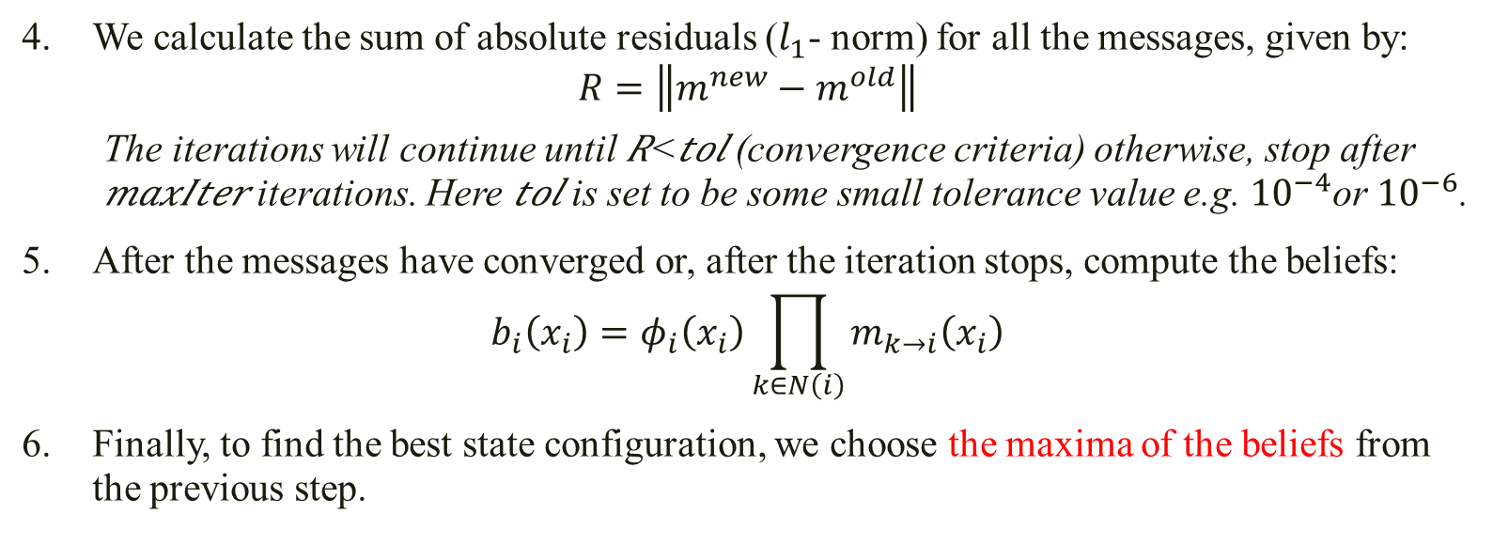
Belief propagation algorithm
We calculate the sum of absolute residuals ($l_{1}$- norm) for all the messages, given by:
$$R=\left\|m^{new}−m^{old}\right\|$$
The iterations will continue until 𝑅<𝑡𝑜𝑙 (convergence criteria) otherwise, stop after 𝑚𝑎𝑥𝐼𝑡𝑒𝑟 iterations. Here 𝑡𝑜𝑙 is set to be some small tolerance value e.g. ${10}^{−4}$or ${10}^{−6}$.
After the messages have converged or, after the iteration stops, compute the beliefs:
$$b_{i}\left(x_{i}\right)=φ_{i}\left(x_{i}\right)\prod_{k∈N\left(i\right)}{m_{k→i}\left(x_{i}\right)}$$
Finally, to find the best state configuration, we choose the maxima of the beliefs from the previous step.

Slide 23
Ryanodine receptor (RyR) (Example : The manual selection)

Slide 24
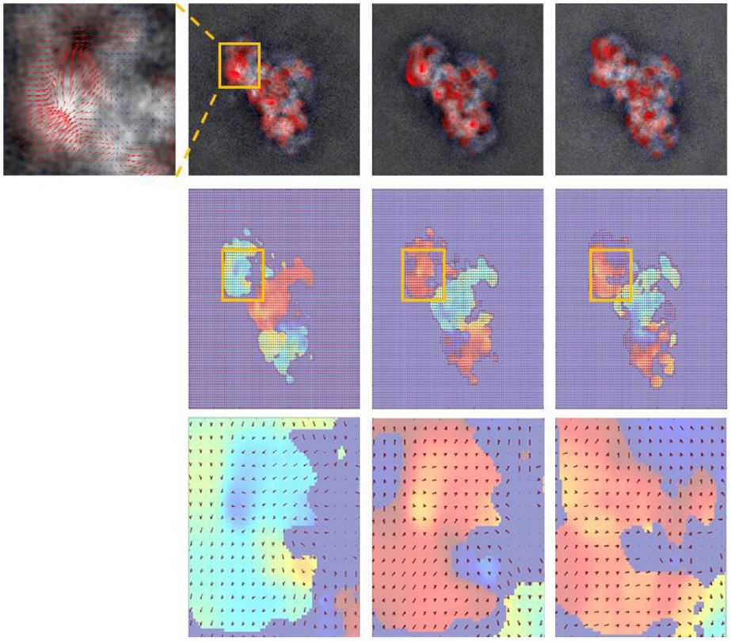
說法一、 220 (+1) 220(-1) 219(+1)
說法二、 220 (+1) 219(+1) 219(-1)
Optical flow
HOG

Slide 25
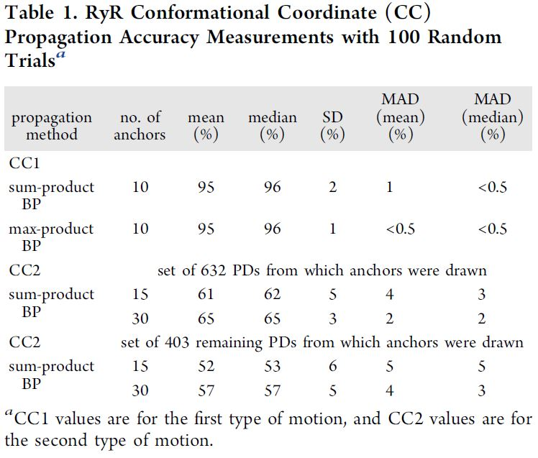

Slide 26
The End

